Slide 1










BCS202L- Data Structures and Algorithms
Dr.Priyanka N
Assistant Professor Senior Grade 1
School of Computer Science & Engineering VIT,Vellore.

Slide 2





BCS202L- Data Structures and Algorithms
Module-1: Algorithm Analysis
Module-2: Linear Data Structures
Module-3: Searching and Sorting
Module-4:Trees
Module-5: Graphs
Module-6: Hashing
Module-7: Heaps and AVL Trees

Slide 3

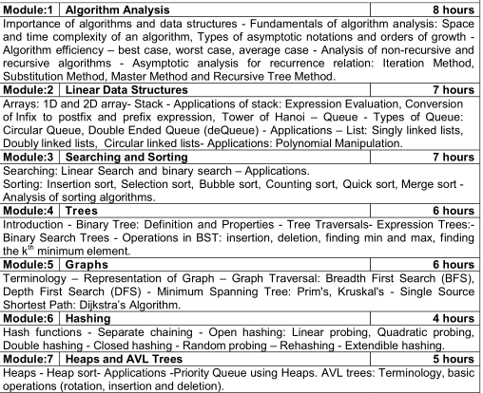

Slide 4

BCS202L- Data Structures and Algorithms
Text Books:
1. Mark A. Weiss, Data Structures & Algorithm Analysis in C++, 4 th
Edition, 2013,Pearson Education.
Reference Books:
Alfred V. Aho, Jeffrey D. Ullman and John E. Hopcroft, Data
Structures and Algorithms,1983, Pearson Education.
Horowitz, Sahni and S. Anderson-Freed, Fundamentals of Data Structures in C, 2008, 2nd Edition, Universities Press.
Thomas H. Cormen, C.E. Leiserson, R L. Rivest and C. Stein,
Introduction to Algorithms, 2009, 3rd Edition, MIT Press.

Slide 5


Module 6: Hashing
Hash functions
Open Hashing( Closed Addressing)
🞄 Separate Chaining
Closed Hashing(Open Addressing)
🞄 Linear Probing
🞄 Quadratic Probing
🞄 Double Hashing
Rehashing
Extendible Hashing

Slide 6


Rehashing
When hash table becomes too full, running time for operations will take more time.
For Example: Insertions might fail for closed hashing with quadratic resolution.
To overcome this type of situation Rehashing technique is used.
A solution, then, is to build another table that is about twice as big (with an associated new hash function) and scan down the entire original hash table, computing the new hash value for each (non deleted) element and inserting it in the new table.

Slide 7
Rehashing
Let us consider f(x) = x % 7 Then,
x | = | 13 | 15 | 6 | 24
f(x) | = | 6 | 1 | 0 | 3
0 | 1 | 2 | 3 | 4 | 5 | 6
6 | 15 |  | 24 |  |  | 13
Applying Linear probing
For Example : if 23 is inserted into the table, the resulting table will be almost full(70%), so new table will be created
0 | 1 | 2 | 3 | 4 | 5 | 6
6 | 15 | 23 | 24 |  |  | 13

Slide 8
Rehashing
IDEA:
The size of this table is 17, because
this is the first prime that is twice as large as the old table size.
The new hash function is then h(x) = x mod
17. The old table is scanned, and elements 6, 15, 23, 24, and 13 are inserted into the new table.
0 | 1 | 2 | 3 | 4 | 5 | 6 | 7 | 8 | 9 | 10 | 11 | 12 | 13 | 14 | 15 | 16
 |  |  |  |  |  | 6 | 23 | 24 |  |  |  |  | 13 |  | 15
Linear
probing

Slide 9

Rehashing
Go to rehashing ,
When table is half full.
When an insertion fails.
When table reaches load factor.
Time Taking Operation
Running time is O(N), since there are N elements to rehash and the table size is roughly 2N

Slide 10


Extendible hashing
Main Hash table is stored in Main memory and the buckets are stored in the disk.
Each value in the hash table is a pointer to a bucket in the
secondary memory.
Hash function is applied on the input value to generate the bucket pointer and perform the operations.
Main Hash Table
Buckets in the secondary memory

Slide 11


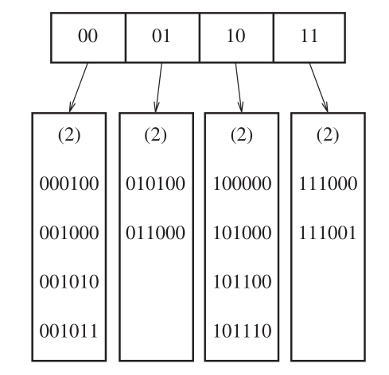
Example
Input our data consists of several 6-bit integers.
To store these values??
The root of the “tree” contains four pointers determined by the leading two bits of the data.
ROOT
D- Number of bits used by the root. So number of entries in the
leaf should be ₂D
Each leaf has up 4 to elements

Slide 12

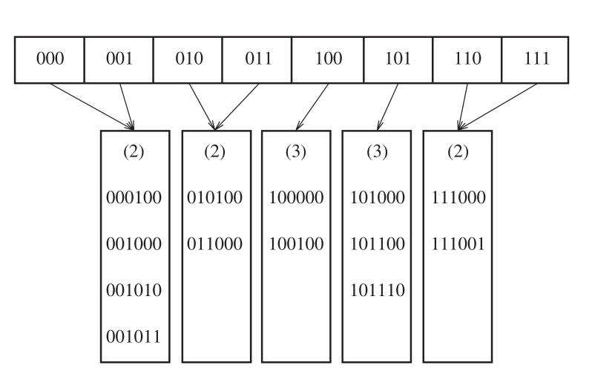
Example
Insert the key 100100, it points to third leaf, but it is already full, so split this leaf into two leaves, which are determined by first three bits.

Slide 13

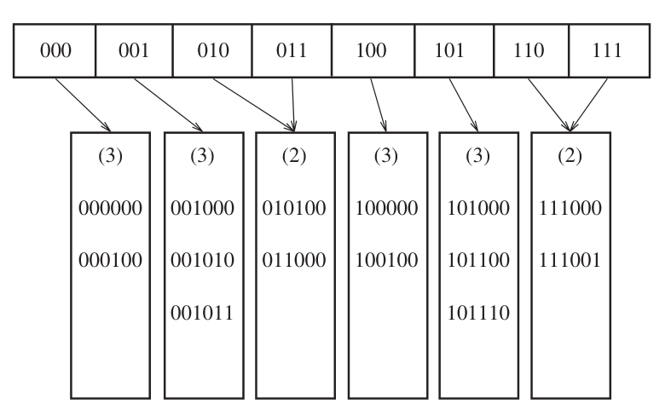
Example
Insert the key 000000, it points to first leaf, but it is already full, so split this leaf into two leaves, which are determined by first three bits.

Slide 14

Extendible hashing
Advantages
Simple
Quick access time for insert and find operations in large databases.
Disadvantages
Not suitable when more duplicates are taken

